Slide 1

Comparative Study of Medicare Payments for Common Conditions Across States 2021

Slide 2

Analysis:
1. CA is the #1 State with the most Medicare beneficiaries while PA ranked 5th.
2. Respiratory Infection and Inflammation is the #1 condition during the year 2021.
3. Heart Failure is the average submitted and paid condition.
4. CA ranked #1 State in Total Discharges while PA ranked 5th.
5. Septicemia or Severe Sepsis is less submitted in NY but got the most Medicare payment.

Slide 3
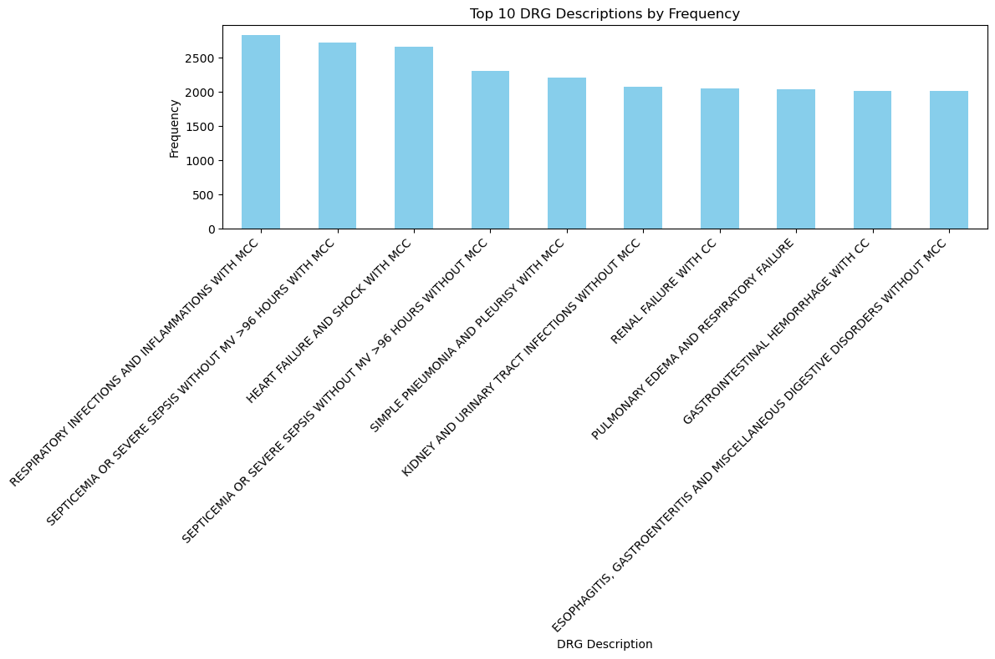
Top 10 Conditions 1. Respiratory Infections and Inflammations with MCC 2. Septicemia or Severe Sepsis w/ MCC 3. Heart Failure & Shock with MCC 4. Septicemia or Severe Sepsis w/o MCC 5. Simple Pneumonia and Pleurisy w/MCC 6. Urinary Tract Infection w/o MCC 7. Renal Failure with CC 8. Pulmonary Edema and Respiratory Failure 9. Gastrointestinal Hemorrhage w/ CC 10. Digestive Disorders w/o MCC

Slide 4
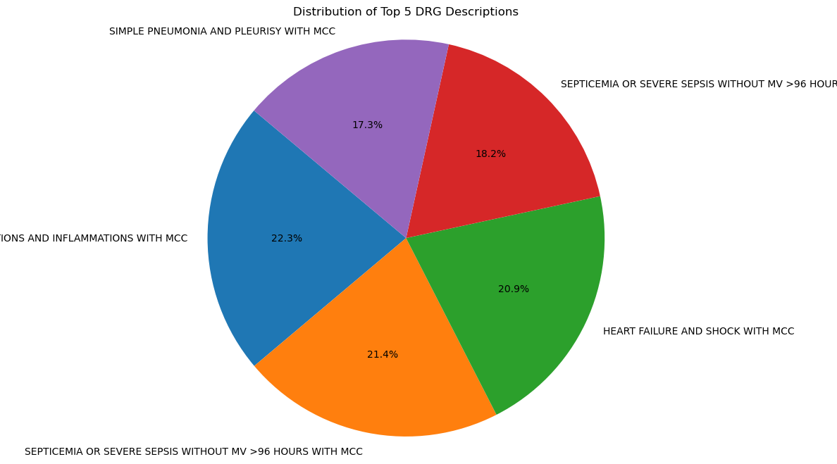

Slide 5
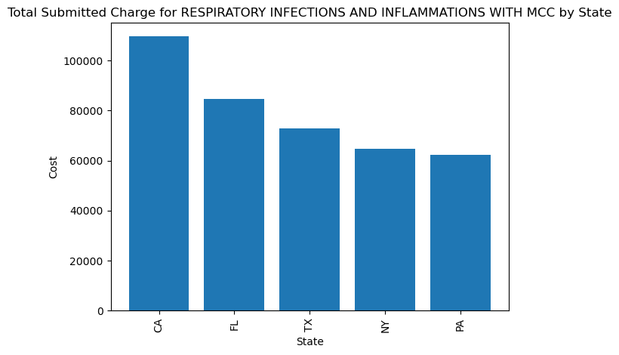
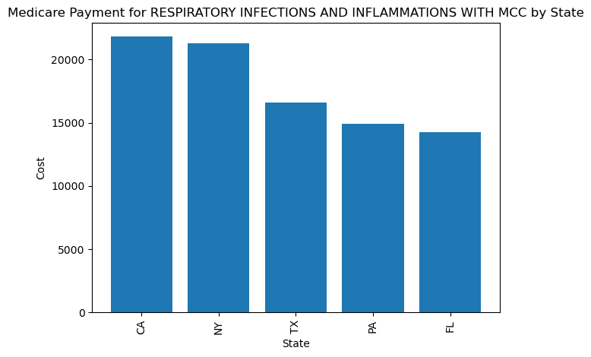

Slide 6
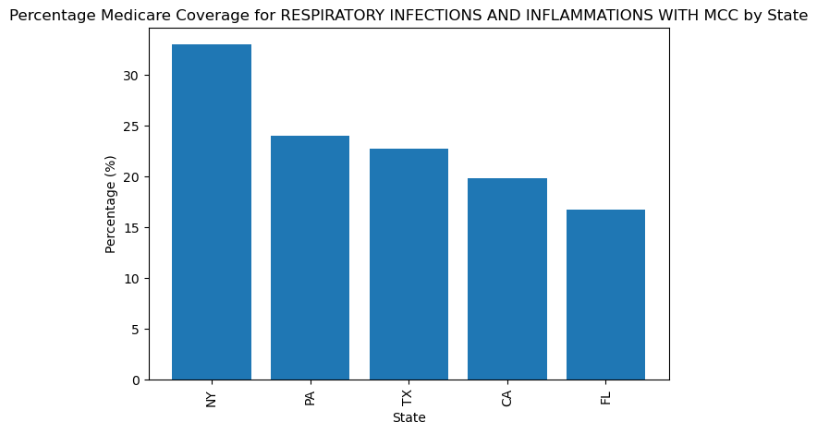

Slide 7
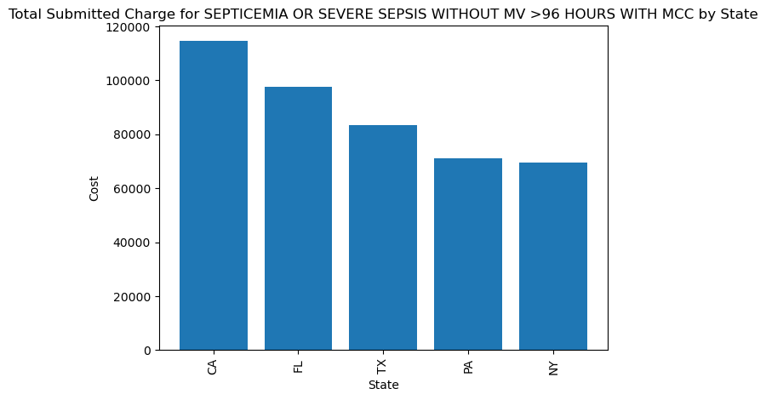
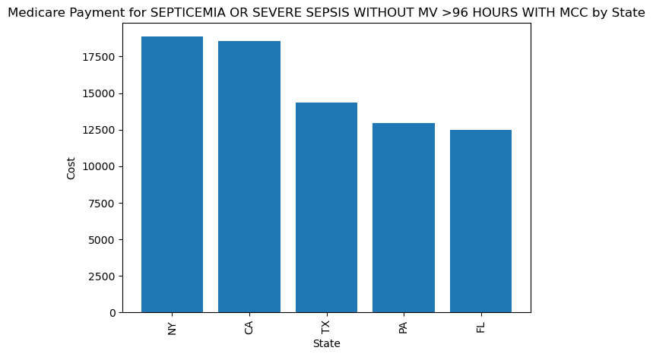

Slide 8
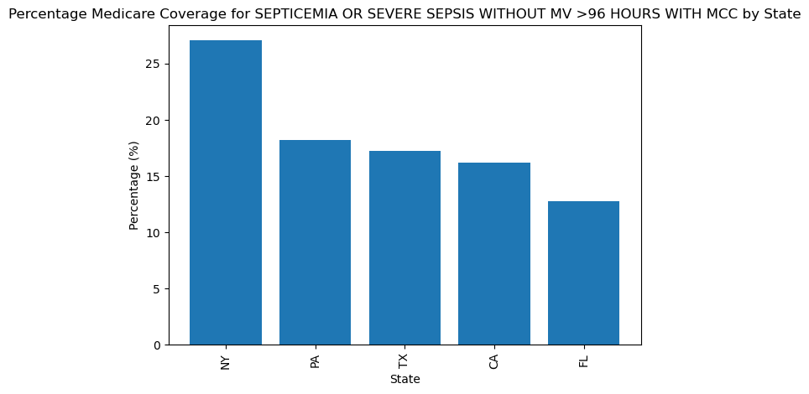

Slide 9
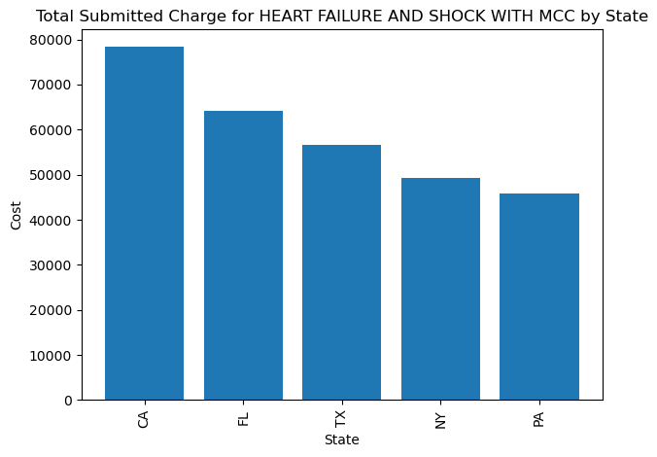
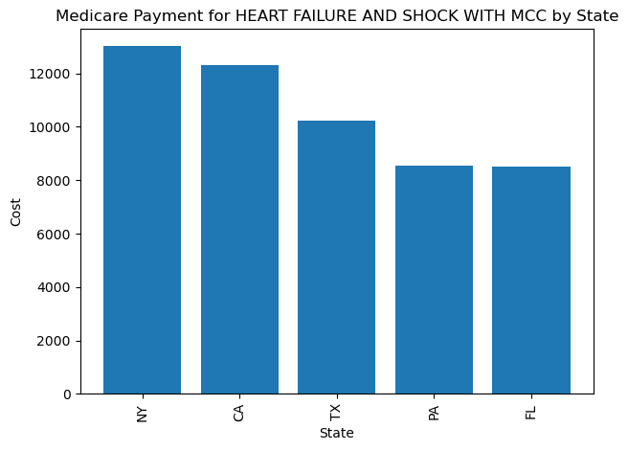

Slide 10
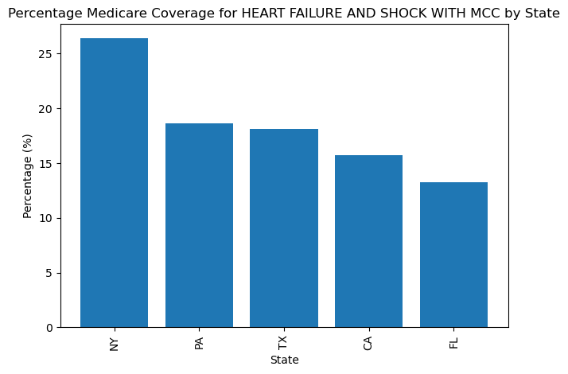

Slide 11
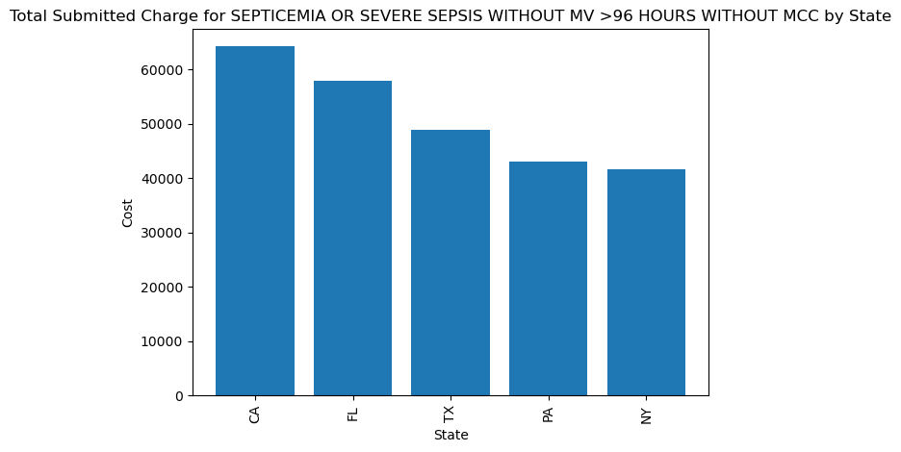
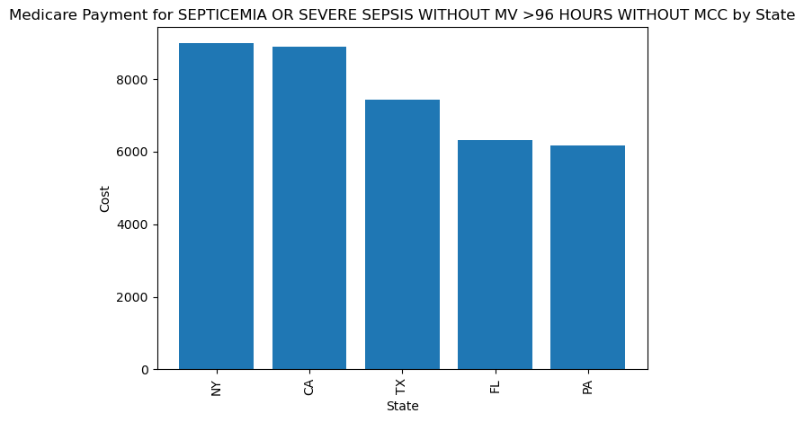

Slide 12
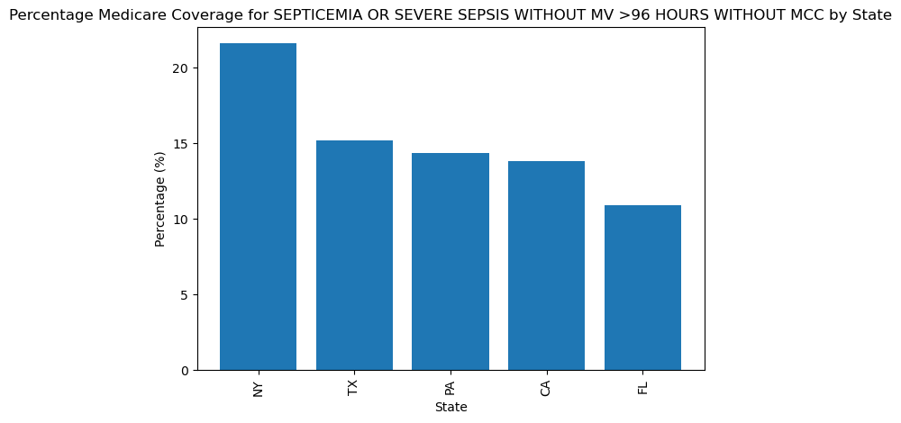

Slide 13
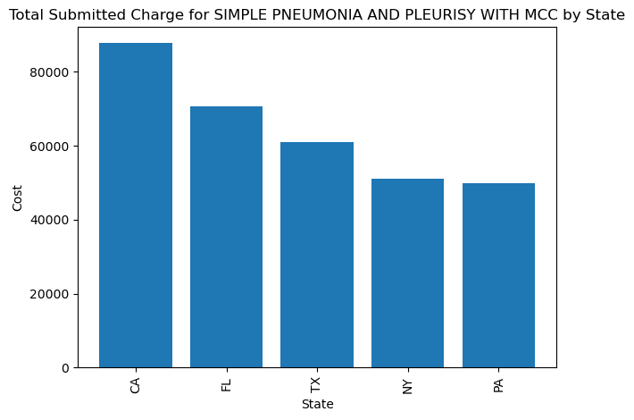
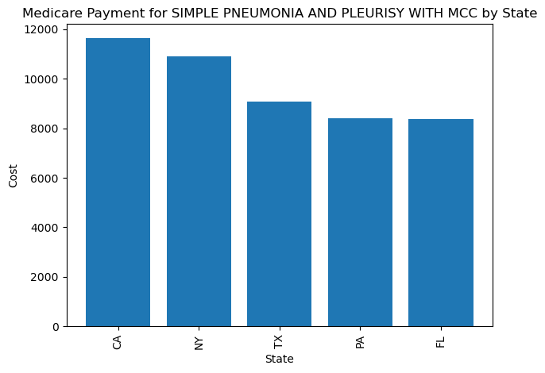

Slide 14
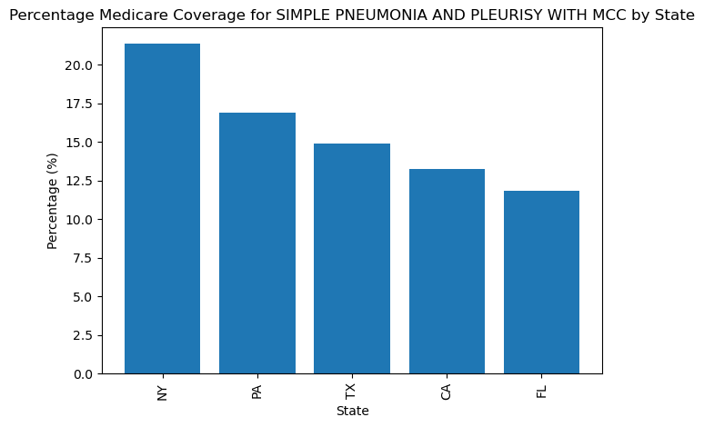

Slide 15
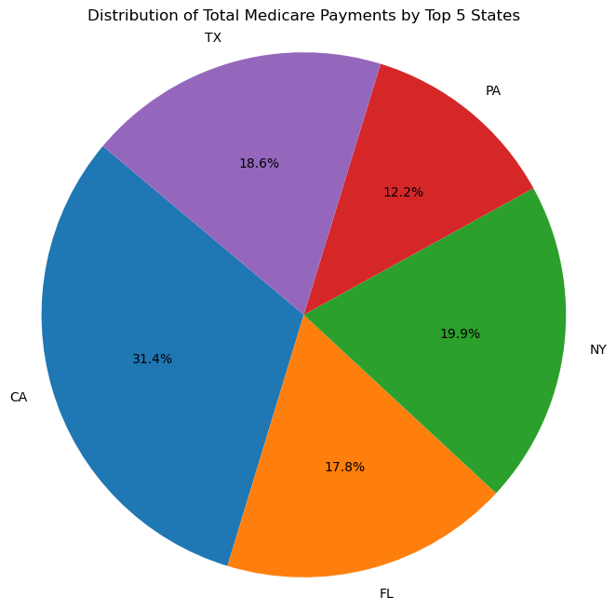

Slide 16
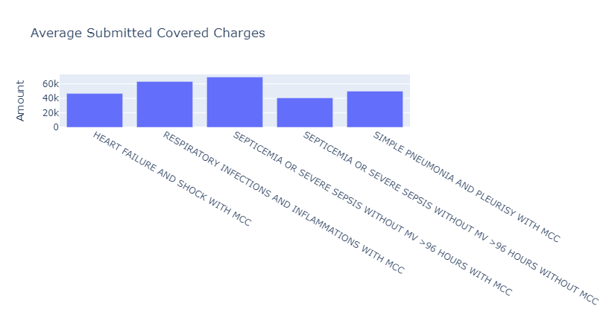

Slide 17
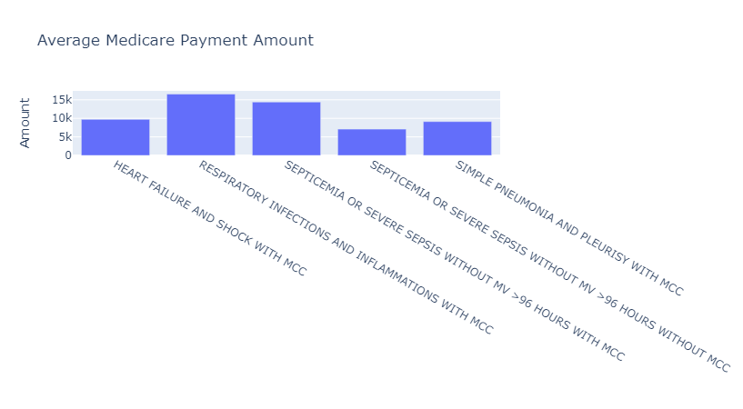

Slide 18
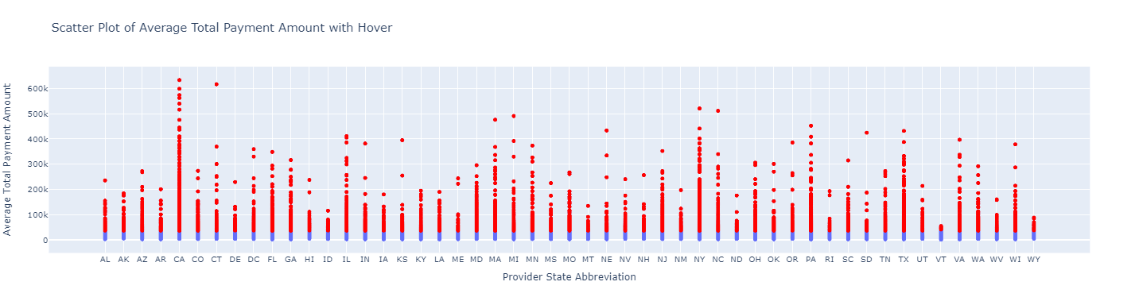

Slide 19
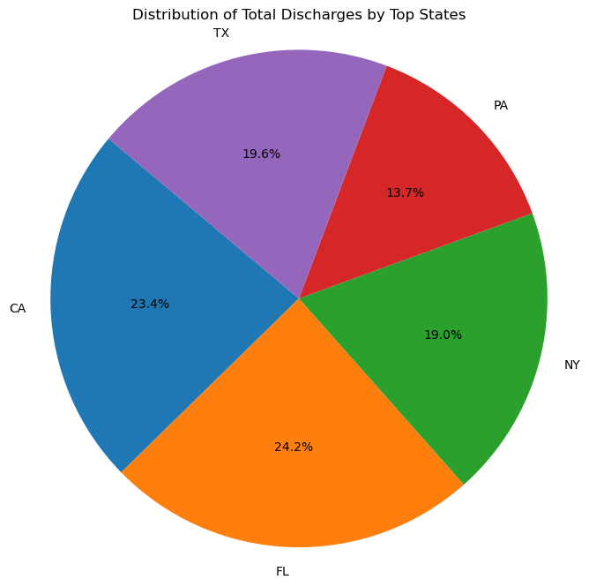

Slide 20
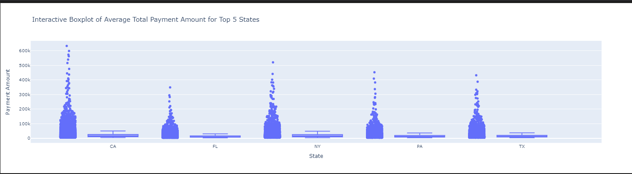

Slide 21
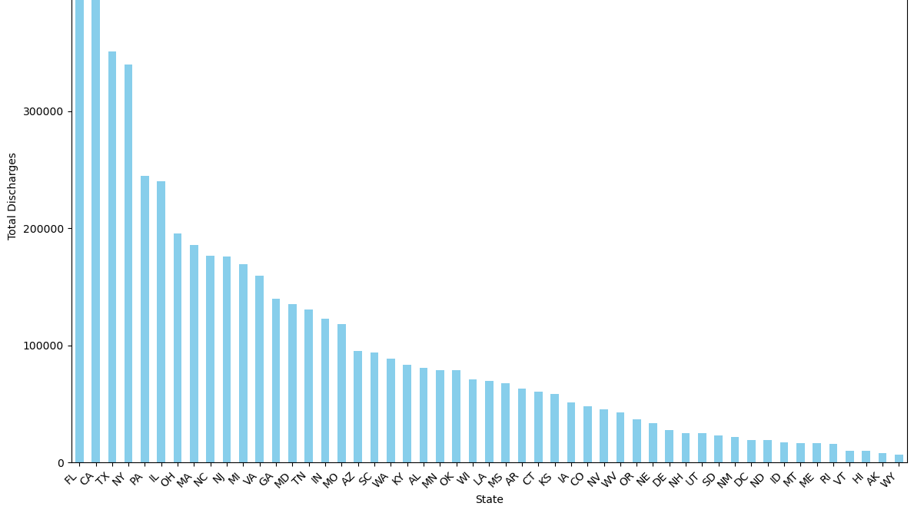

Slide 22
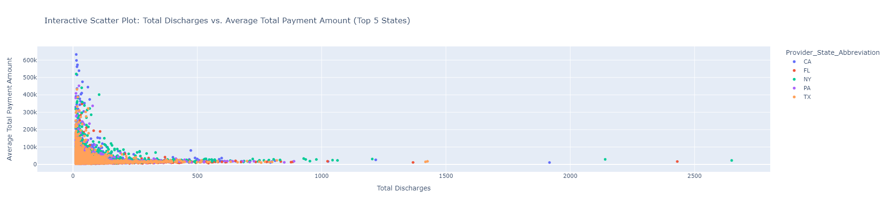

Slide 23
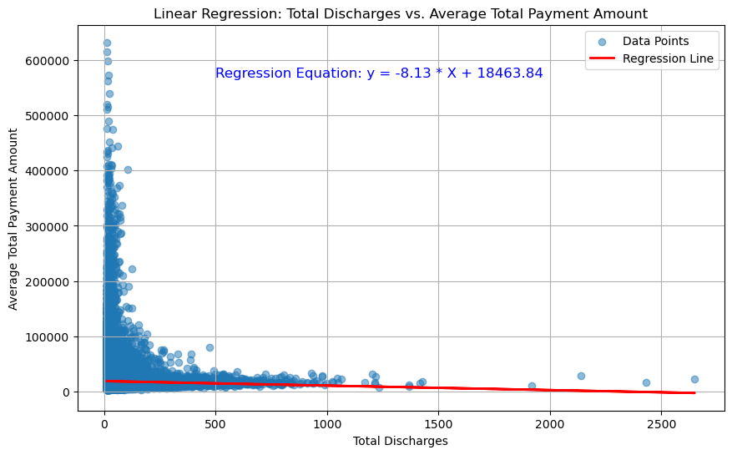

Slide 24

Thank you!!!!
Ved
Keri
Teresita
Eirynell
Group 6

Slide 25
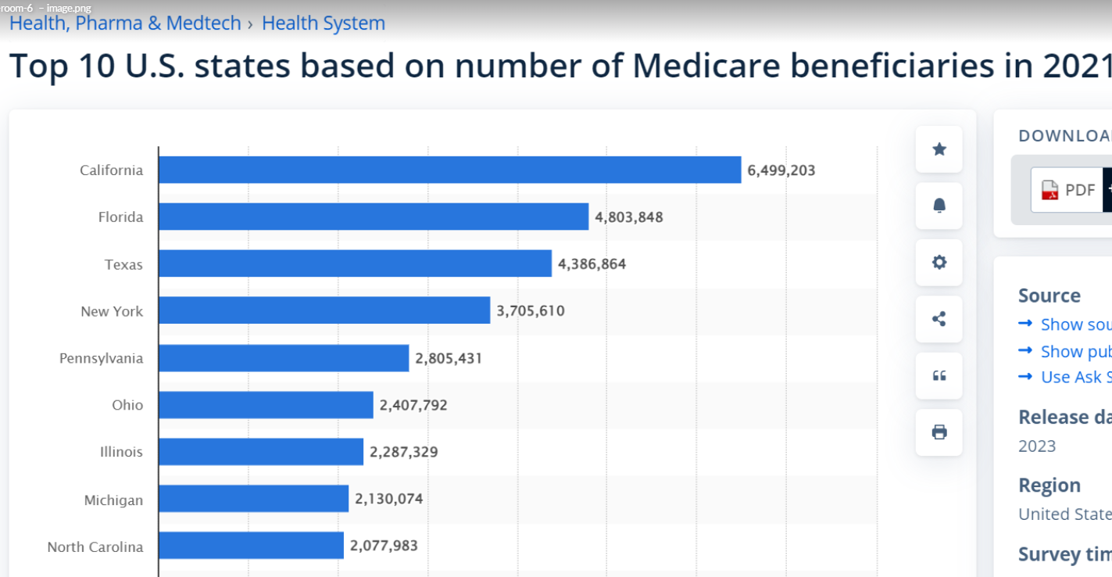

Slide 26
